Slide 1
Modeling Backbone Resemblance and Redefinition in Alloy
Andrew McVeigh, 24th April 2007

Slide 2
Structure of the model

Slide 3
Main signatures

Slide 4
Contained elements...

Slide 5
1 parameterised module for modeling deltas and merging...

Slide 6
Module structure of Alloy model
deals with visibility, and resolving ids
all the sigs
all the merge, redefinition and resemblance logic

Slide 7
Concepts and Findings

Slide 8
How does it work?
IDs add a needed level of indirection
  but approach allows us to refer directly to components
2 stages for removing resemblance / redef:
  rewrite resemblance graphs for each stratum to take redefinition into account
  merge and copy across contained elements so direct references to a component will work
This allows us now to concentrate on well-formedness...
  i.e. for each stratum, is a component well formed?

Slide 9
How does merging work?
Merge works as follows:
For each component...
  take the objects from what we directly resemble and add them all into a single relation ID -> Object
  remove any IDs that any other “resembler” has deleted, unless they have been replaced
  add, delete and replace our deltas
After merging, we can ignore resemblance / redefinition
Finally, check to see if we have 1 Object per ID!

Slide 10
Key findings: Merge and resolution
A merge error is:
  not having a single element per ID (i.e. zero or >1)
  Check is simple
  Replace or delete can always resolve
    Delete will remove all objects for an ID
    Replace will replace all objects for an ID with 1 object
objects is a relation
ID -> Object
pred Deltas::oneObjectPerID(s: Stratum)
{
let objects = this.objects_e[s] |
function[objects, dom[objects]]
}

Slide 11
Key findings: Resemblance
Multiple resemblance is possible
Redefinition can be rewritten as resemblance
  Merging is handled via multiple resemblance
Redefinition and resemblance don't have to align
  key well-formedness criterion is simple that you don't contain yourself (with a small twist...)
let
original = no c.redefines => c else c.redefines,
firstResemblesAndComposes =
c.resembles_e.s - c.redefines + c.parts.s.partType,
resemblesAndComposes = resembles_e.s + parts.s.partType
{
original not in firstResemblesAndComposes.*resemblesAndComposes
}

Slide 12
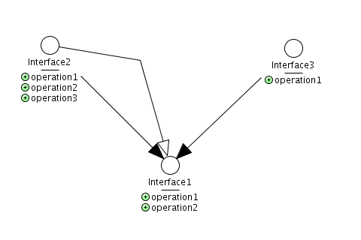
Key findings: Interface subtyping
Resemblance applies to interfaces also
Subtyping is a subset of resemblance
  It breaks when an operation is removed or replaced...
i.superTypes.s =
{ super: i.resembles |
super.myOperations.objects_e[s] in
i.myOperations.objects_e[s] }

Slide 13
Key findings: Modeling approach
It is not necessary to flatten to model resemblance and inheritance and well-formedness...
  This is important for the CASE tool
Interesting finding:
  Alloy has no recursive functions
  but, resemblance is best specified as a recursive fn
  the only way to do this in Alloy is by specifying predicates across all possible parameter combos.
  leads to an incremental checking approach for the case tool... -> i.e. a +ve from a -ve

Slide 14
Status
Model for resemblance / redef is complete
  Can graph in jUMbLe again
  Can show conflicts and various other properties
Model is directly applicable to CASE tool
  about to start refining to implementation...
  old implementation is complex and incorrect in parts
Next is flattening semantics
  Have early Darwin papers to refer to
  Will rephrase an an Alloy model to refine and implement...
Also working on transfer report... due next mth.

Slide 15
Other points
Port remapping
  required when replacing a part
Consistent approach to resemblance
  only components can be resembled / redefined
  plan to wrap each leaf in a composite
Global stratum are not possible
  cannot get rid of cycles...
SAT solving isn't so bad (maybe...)
  I can generate snapshots of up to 8 components in < 1hr

Slide 16
Example: Simple redefinition

Slide 17
Delta view

Slide 18
Resemblance from Stratum3

Slide 19
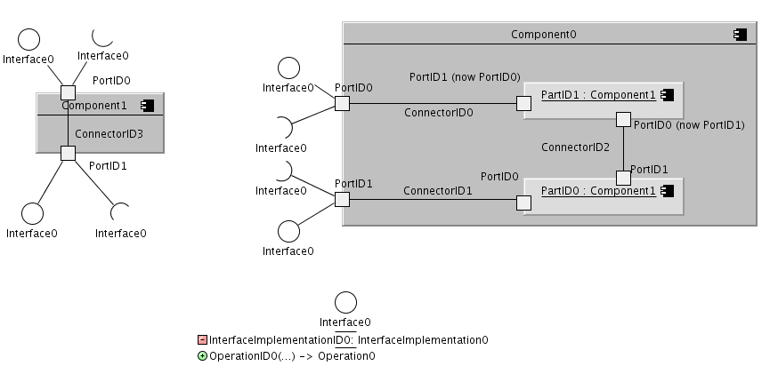
Final view from Stratum3

